Slide 1
Present Perfect Simple

Slide 3


Talking about events or actions of the past.
Yesterday, I ate 3 apples.
Today, I have eaten 3 apples.
Last month, she drank 4 litres of milk.
This month, she has drunk 5 litres of milk.
Which past action is connected to now?
So, how do we form the Present Perfect Simple?
subject + have/has + past participle.
The past participle of regular verbs end in -ed, just like in the past simple.

Slide 4
When do we use the Present Perfect Simple?
Tell me,
Has yesterday finished?
Has last month finished?
Has today finished?
Has this month/year finished?
When the time has finished, we use…?
When the time still hasn't finished, we use…?

Slide 5


What do these three statements have in common?
I have eaten squid.
I ate squid.
I have eaten squid 3 times.
I have eaten squid since the age of 8.
PAST
NOW
FUTURE
PAST
NOW
FUTURE
PAST
NOW
FUTURE

Slide 6
When do we use the Present Perfect Simple?
Use Past Simple | Use Present Perfect Simple
Last year... | This year...
Last month... | This month...
Yesterday... | Today...
Last week... | This week...
In 2017...

Slide 7
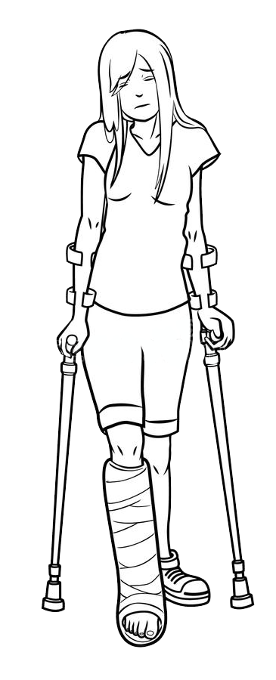
When do we use the Present Perfect Simple?
To talk about situations that started in the past and are still true.
I have lived in Bilbao for two years.
To talk about an action that started and finished in the past but the time is unknown or unimportant.
Why is Sarah not playing tennis? She has broken her leg.
I haven’t seen the new James Bond film.
We have opened the windows to get some fresh air.
When we use ever, never, already, yet and just.
Have you ever been to Timbuktu? No, I’ve never been to Timbuktu.

Slide 8

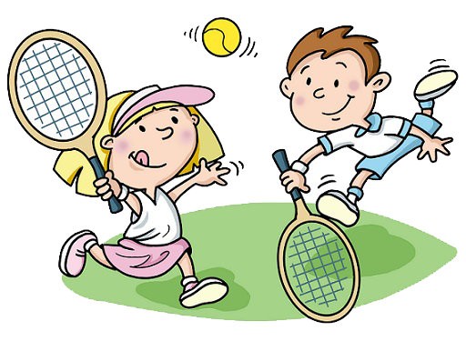

Examples.
Last month, I visited my Grandmother twice.
This month, I have visited my Grandmother once. (The month hasn't finished yet, so there is more time to visit her again).
Last year, I played tennis with Sarah.
This year, I have played tennis with Sarah many times.
(The year hasn´t finished yet, so there is more time to play tennis)
In 2017, I lived in Bilbao.
I have lived in Bilbao since 2017.
(Do I still live in Bilbao?)

Slide 9
Interrogative forms...
How do we make a question with have or has?

Slide 10


When do we use the Present Perfect Continuous?
To talk about actions/situations that are continuing up to now.
I have been reading a great book.
To talk about an action that started in the past and ended recently.
Why doesn’t Lucy understand?
Because she has been chatting to her friend all lesson and hasn’t been paying attention.
To talk about an action that started in the past and is still true - emphasis on time.
We have been waiting for three hours.
We have waited three hours.

Slide 11
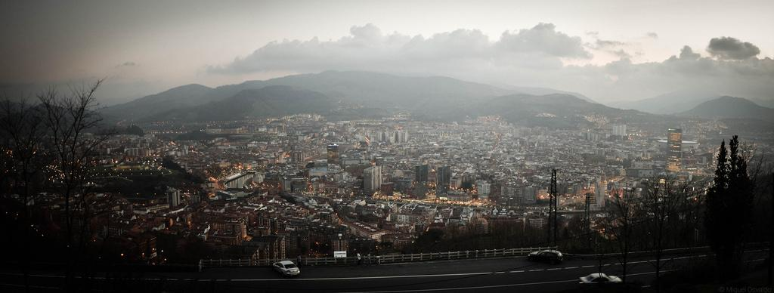
Present Perfect simple or continuous?
Aren’t both used to talk about situations that started in the past and are still true now?
Have you lived in Bilbao for very long? I have lived in Bilbao since 2017.
2) How long have you been living in Bilbao? I have been living here for more than two years.

